Slide 1
Voting Feature
User Guide

Slide 2
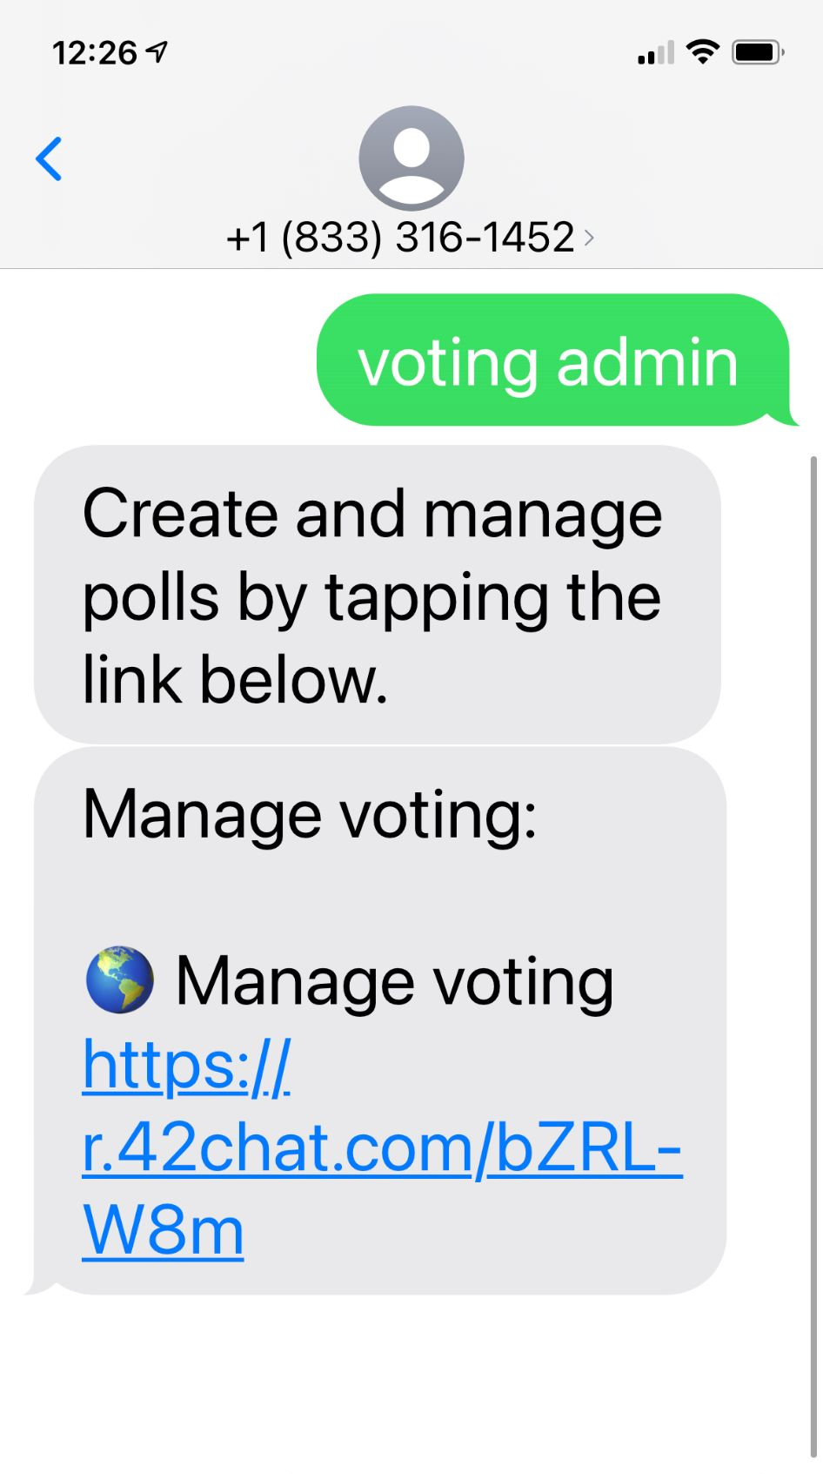
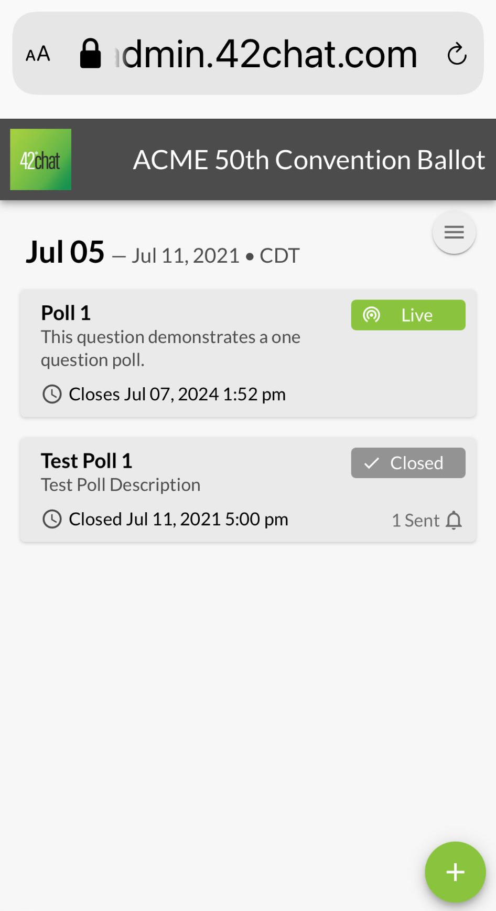
Admin Poll Access
Text “Voting Admin” to your chatbot
Tap the + button to add a poll

Slide 3
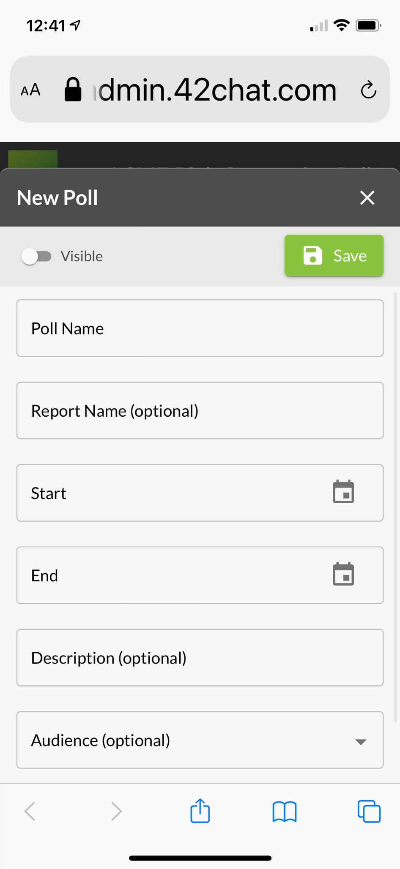
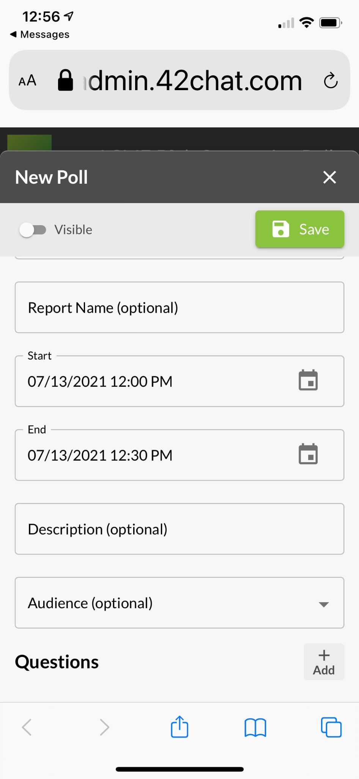
Set Up Polls
Enter the following
Poll Name
Report Name (Optional)
This will be the title of the data download report for this poll
Start Date and Time
End Date and Time
Description (Optional)
Audience (Optional)
The poll will send to all eligible voters unless an audience is selected.
Audience options narrows the poll audience from all eligible voters to custom roles if configured in the bot.i

Slide 4
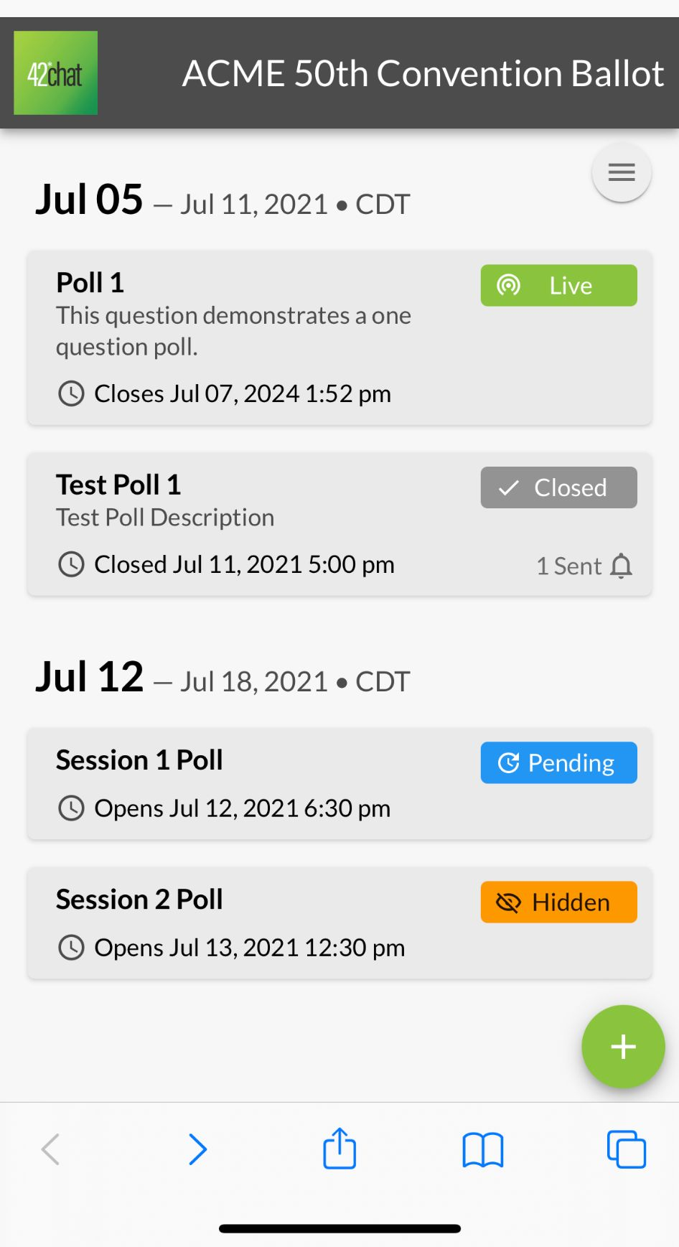
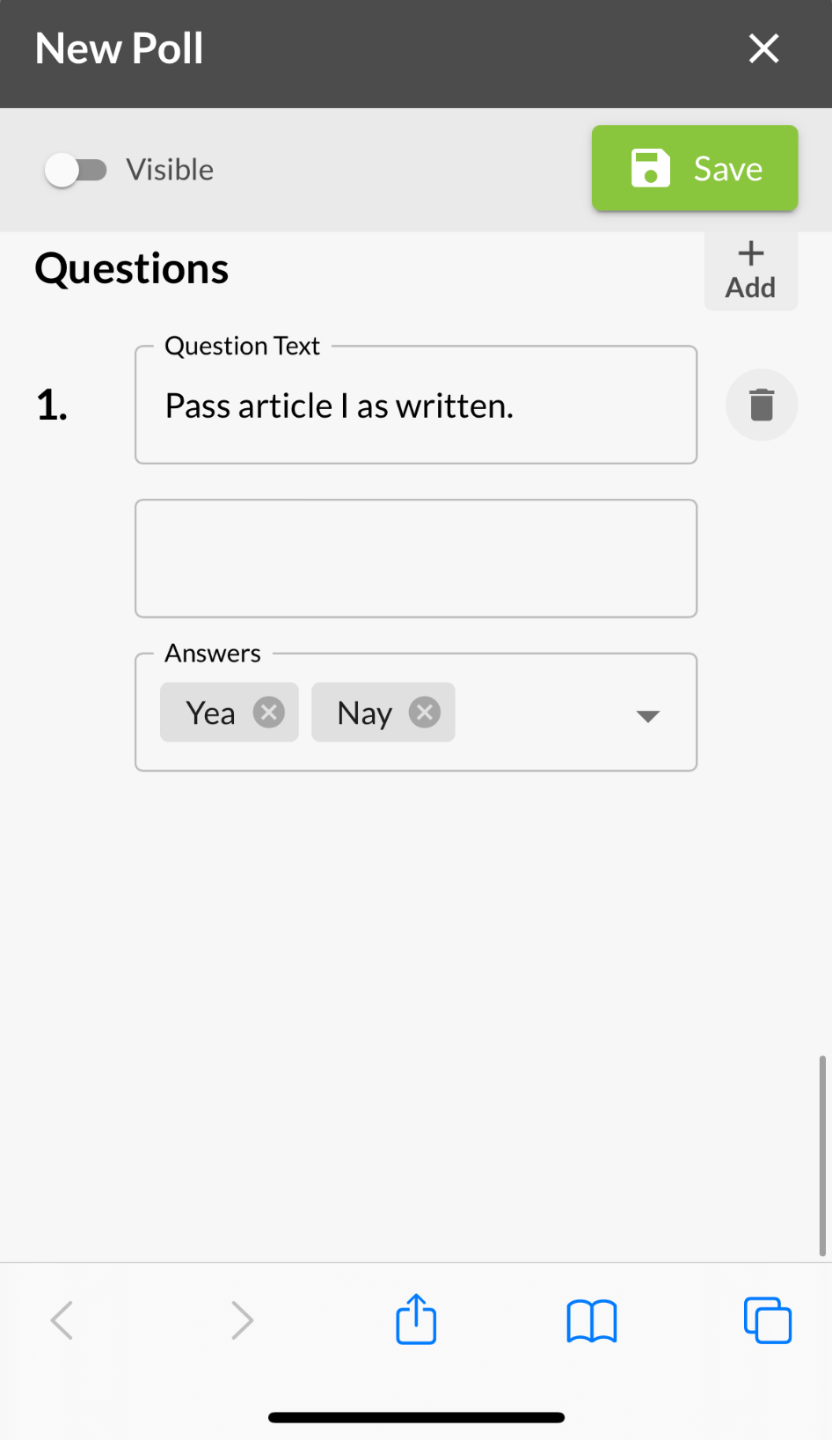
Add Questions
Add questions to the poll
Question Text
Report Column Header
In the CSV data download report, this will be the column title for this question
Answers
Default selections are Yea, Nay
Additional answer options can be added by typing them into the answer box and hitting return.
Add additional questions
Select ‘Visible’ if you would like the poll to be visible in the list of polling questions
Note the poll start and end date/times must be current for the poll to be visible.
Save

Slide 5
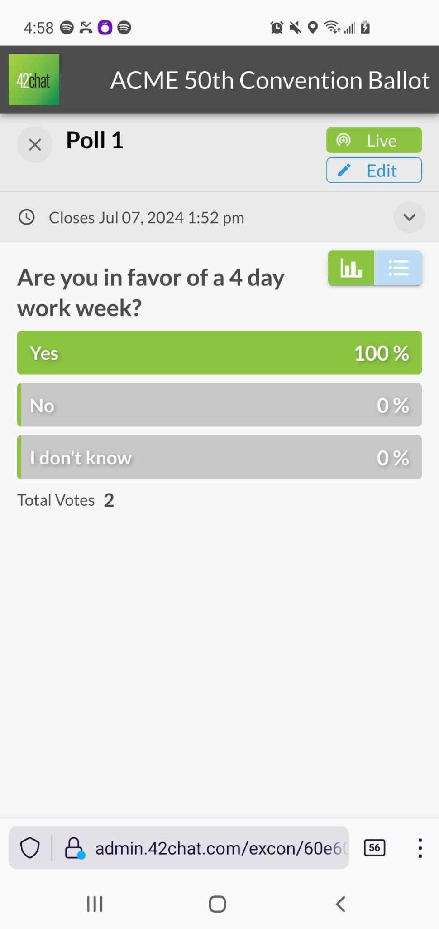
Edit a poll
To edit a poll
Select a poll from the poll list
Select “Edit” button /pencil icon
Edit as desired
NOTE: Once votes have been cast for a poll, the following can no longer be edited
Poll start date
Poll questions
To delete a poll
Select the “trash can” icon and follow the prompts
NOTE: if a poll is deleted after votes have been cast, all data will be lost.

Slide 6
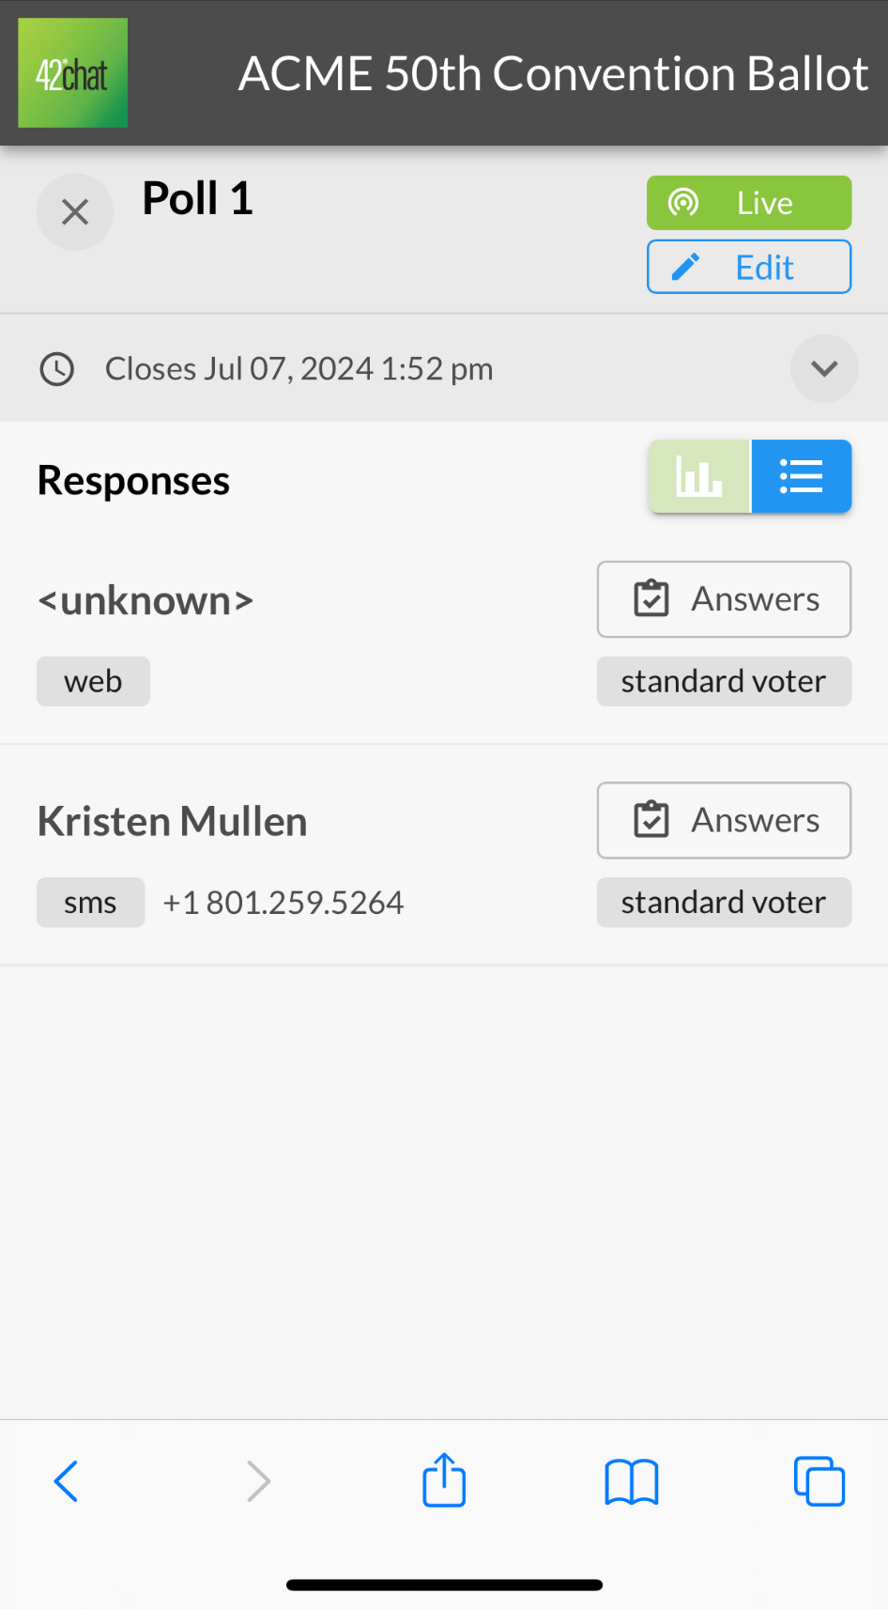
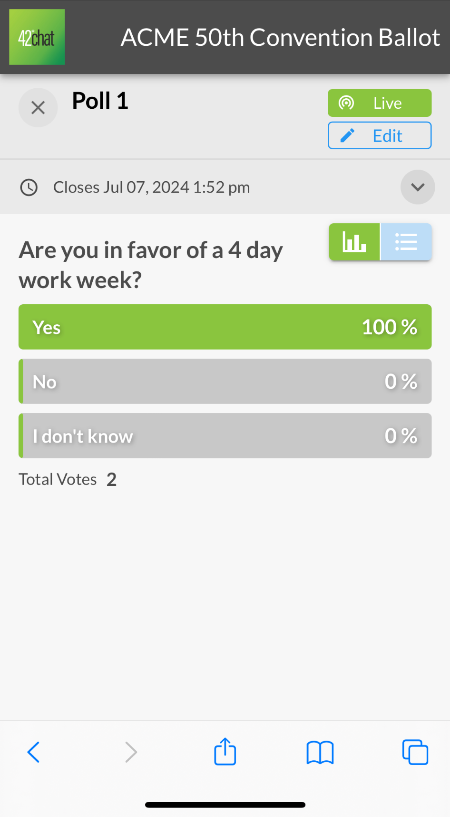
View Results
To View Results
Select the green bar graph icon to see the results by poll question
Select the blue data list icon to see the results by voter
NOTE: Once votes have been cast for a poll, the following can no longer be edited
Poll start date
Poll questions
Admin users can send reminders if the poll is active and visible
Reminders are configured by 42Chat
Only one of each reminder configured can be sent per poll
Results by poll question
Results by voter

Slide 7
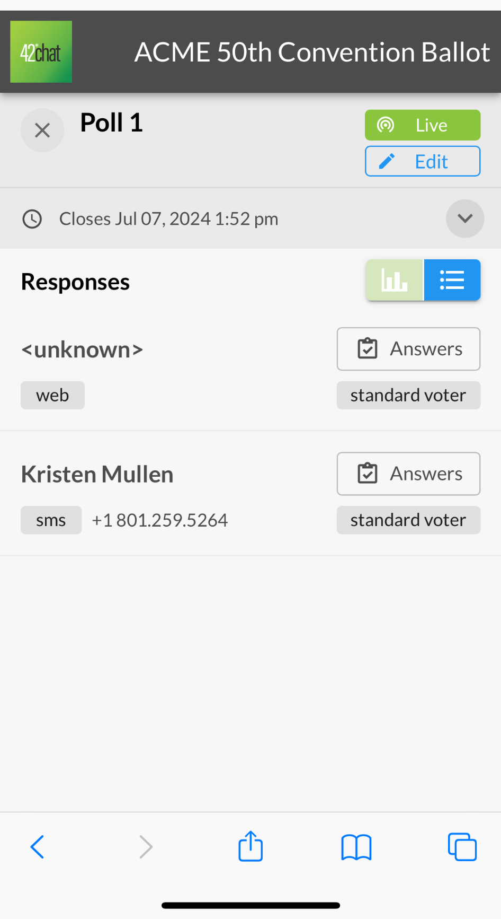
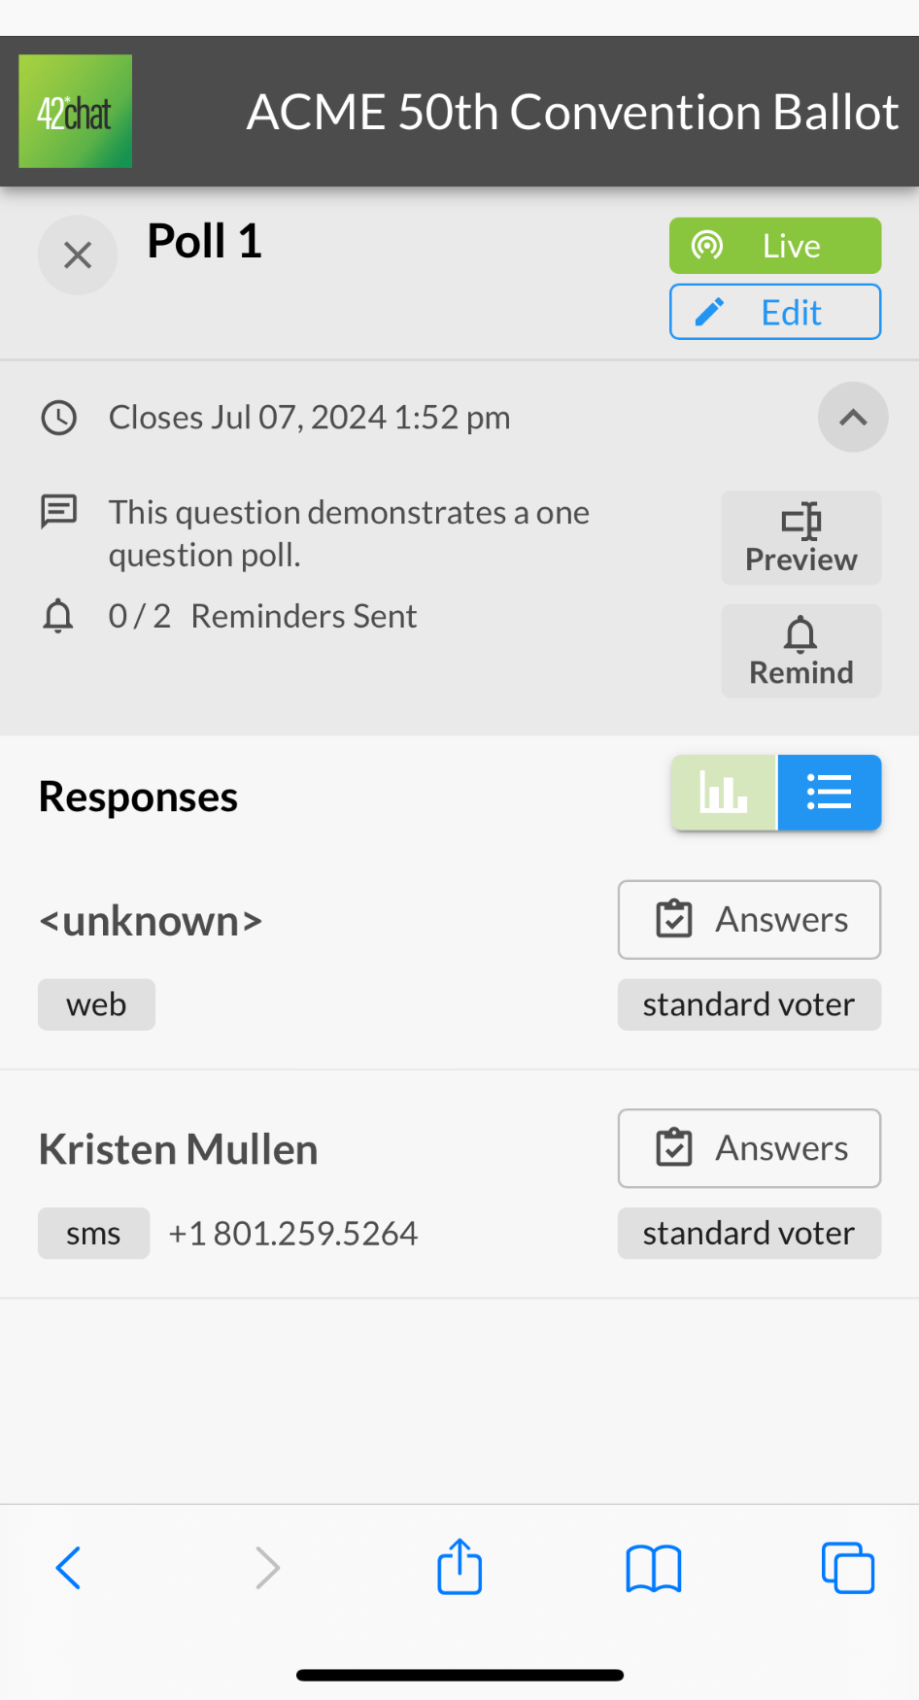
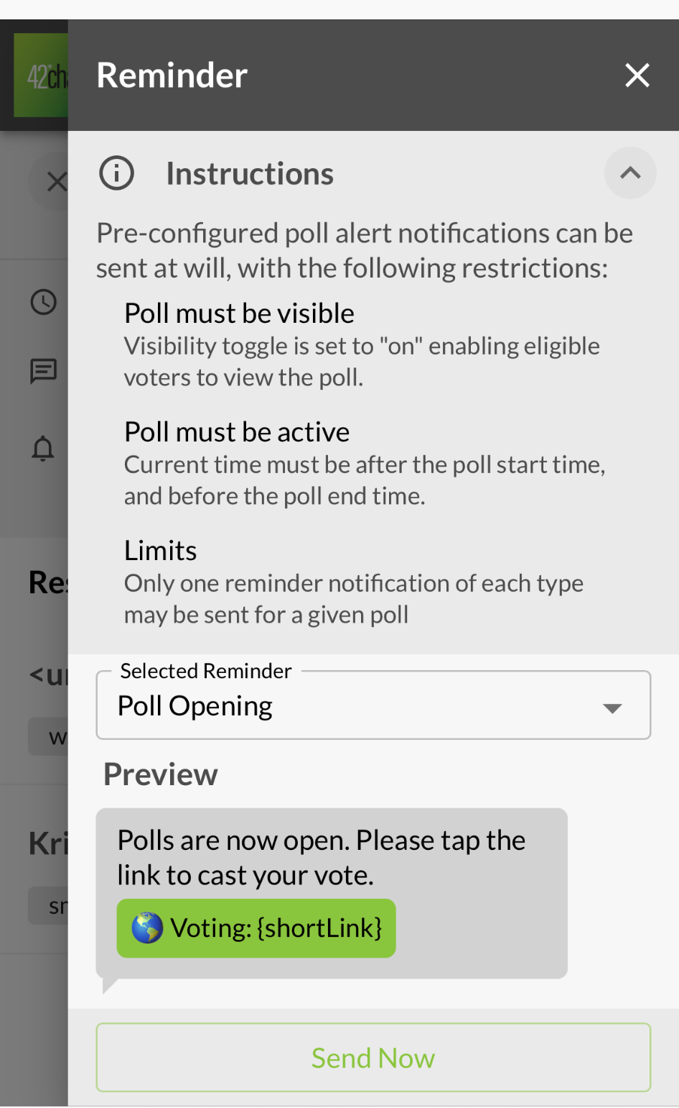
Send Reminders
Reminders are pre- written by 42Chat Customer Success
Only one of each reminder configured can be sent per poll
Select the down arrow button
Select the ‘Remind’ Button
Select the reminder you would like to send
Select “Send Now”
Admin users can send reminders if the poll is active and visible

Slide 8
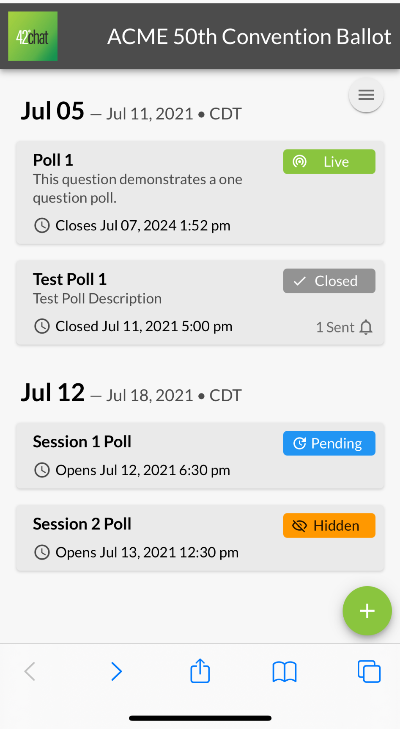
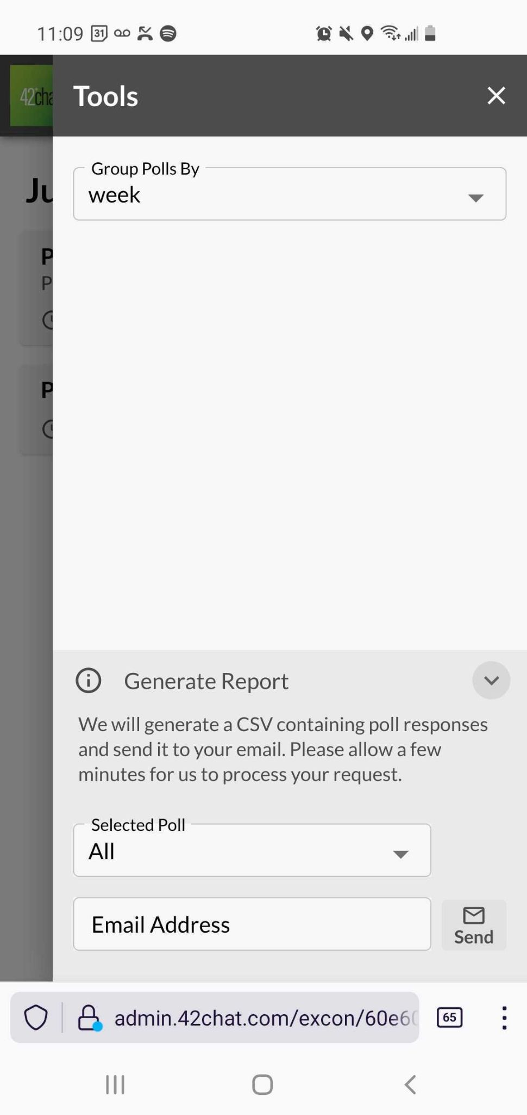
Download CSV of Poll Results
Select the "hamburger" button at upper right
Select “Group polls by”
Select “Generate Report”
“Selected Poll”
All
Individual polls
Enter “Email Address”
Select “Send”

Slide 9
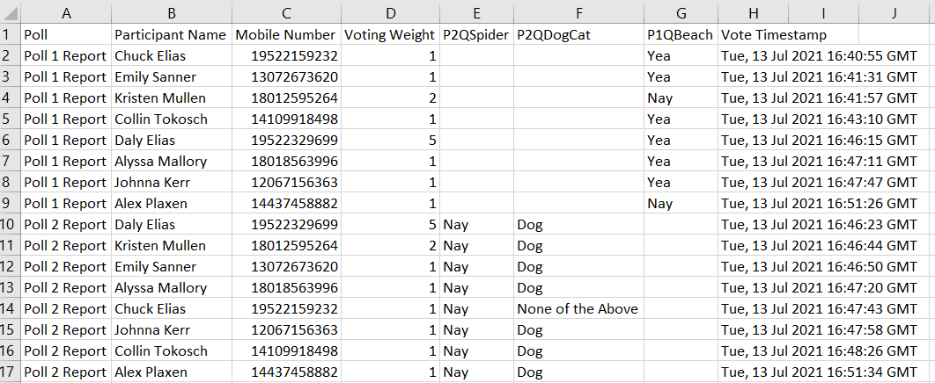
Download CSV of Poll Results

Slide 10
42Chat Support
Alyssa Mallory
Director of Customer Success +1.801.856.3996 alyssa.mallory@42Chat.com

Slide 11
Recognized for Innovation

Slide 12
